Slide 1

Pole to Pole
A resource for exploration in Bipolar
Carers’ Information Strategy: 2011-12; 2012-13; 2013-14.
NHS Fife Research and Development: 2013-14.
Notes:
Carers’ Information Strategy Funding: 2011-12; 2012-13; 2013-14.
NHS Fife Research and Development Funding: 2013-14.

Slide 2


Edie Gledhill, Facilitator
Isobel Duncan, Facilitator
Lorraine Sorley, Facilitator
Gordon Mitchell, Consultant Clinical Psychologist
Laura Walton, Clinical Psychologist
Lindsey-Jo Sevier-Guy, Psychology Assistant
Emma-Louise Butchard, Psychology Assistant
Graeme Babbs, Senior Graphic Designer

Slide 3
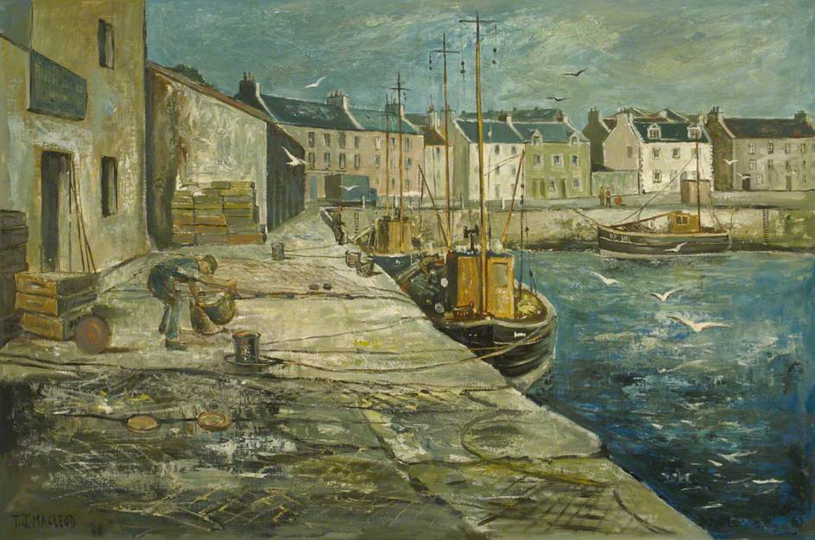
THE BEGINNING …
Torquil J. MacLeod
Notes:
Rationale
People present with need to talk about their experiences
The relapse prevention approach – describe using the Polygraph metaphor
Increased fusion; avoidance; rather than value based; focus is on “not being ill” rather than living well; “be careful” – relapse prevention control based;
The 3 systems and clinical experience of
Opportunity for collaboration/existing links

Slide 4
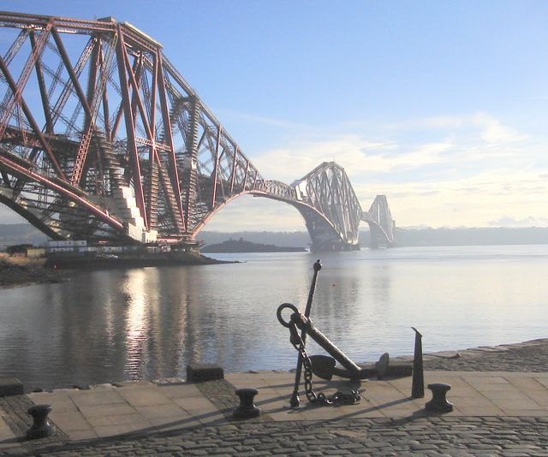
…the Journey …
Notes:
Development of the concept
Design and graphics
Focus groups
Revision
Production

Slide 5
Exploration
& Communication

Slide 6
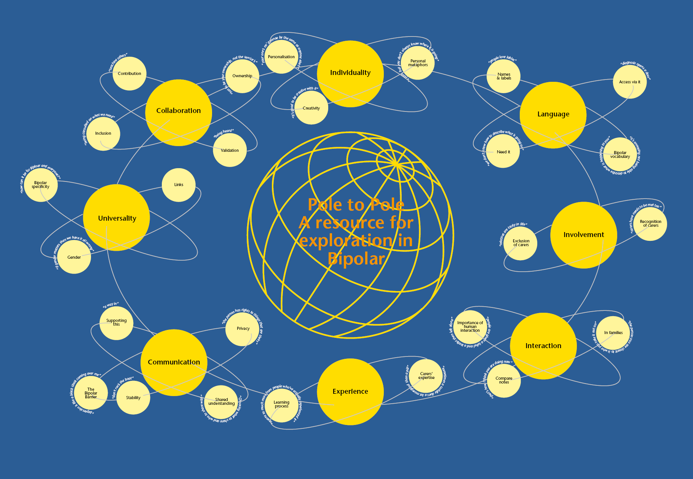

Slide 7
Safety
Connection
Drive
Notes:
THE MAP
One way of looking at these states is to divide them into separate areas which we can think of as varying on a sliding scale. In this tool we have identified three areas:
SAFETY
This area describes the extent to which you feel safe. When our state is high on the scale of safety, we feel that we are in danger of some threat, either to our personal safety or to our character or position in life. When our state is low on the scale of safety, we may lose sight of the need to protect ourselves, and even put ourselves in high risk situations.
DRIVE
This area describes the extent to which we motivated to engage in activity. When our state is low on the scale of drive we may find it impossible to do anything at all. When our motivation is high on the scale of drive, we may find ourselves becoming constantly active, doing is much as we possibly can, and maybe more than is doable.
CONNECTION
This area describes the extent to which we are able or willing to connect with other people, and also ourselves. When our state is low on the scale of connection, we may find that we want to hide away from the world, and may not even be able to bear being with ourselves. On the other hand when our state is high on the scale of connection we may want to be with people all of the time and perhaps be “the life and soul of the party”.
THE MAP is designed to help you to explore your own states, and describe your mood, body, thoughts and behaviour when you are at different points on the sliding scales for each state.

Slide 8
Notes:
People vary in the states that we are most comfortable in. Understandably, when we find the current state uncomfortable or distressing, we seek a way to change it using one of the above. Unfortunately this sometimes brings its own problems, because in trying to avoid an uncomfortable state, we can end up behaving in ways that we would otherwise prefer not to. This takes us to the second part of the tool:
THE TRAVEL GUIDE
We all have values. A value describes that which we believe to be personally important to us. We each have a unique set of values which guide the direction we take in life. We are most engaged with life when we are able behave in ways that our consistent with our values. HOWEVER, often there are obstacles that prevent us from living according to our values. These obstacles can be external ones, coming from the situation we are in or the people around us, or they can be internal obstacles such as our mood, beliefs or physical condition. The state we are in can also become a barrier to living according to our values. When this happens, we can become stuck.
THE GUIDE takes the form of a ripple. It is designed to help you to identify your own values and to consider to what extent you are living according to these values. Are you stuck in the centre, or are you moving outwards?
Values
Obstacles
Work-arounds

Slide 9
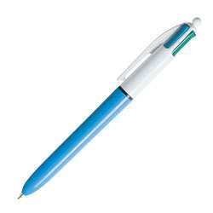
Notes:
GIVE OUT MOCK UP
DESCRIBE CONTENTS
I will tell you about each part of the resource in turn.

Slide 10
Can’t keep up with thoughts
Sally Smith
No sleep
Agitated
No fear
Talking to everyone
Full of energy
I want to be with friends
The “ok” zone
Getting things done
Safe and secure
Sociability
Motivation
Content
Tense
Shaky
“I’m bad for people”
Thoughts are clunky
“It’s not safe”
Body curls up
Heavy

Slide 11
John Jones
Alarm System
Relationships
Getting going

Slide 12
Sally Smith
Home
Taking care of self
Relationships
Learning

Slide 13
John Jones

Slide 14
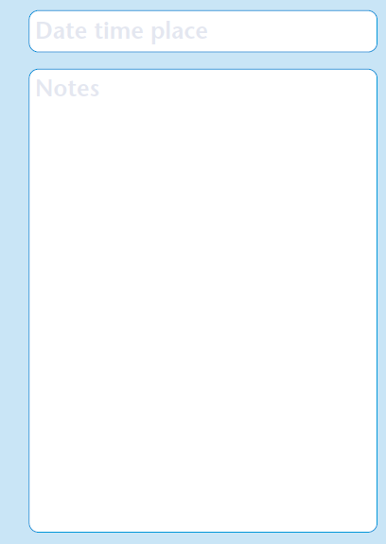
Notes:
THE TRAVELOG
There is a lot of variation in our states and in the extent to which we are able to live according to our values. It is therefore helpful to keep a record for a time.
THE PASSPORT is designed to provide you with a structure to collect additional information about your own states and values, (which you can add to the MAP and GUIDE). It is also a record that you will be able to look back at.

Slide 15
Sally Smith
Tuesday 5th February
8:30am Didn’t sleep, got up feeling awful.
11am Nothing done, too exhausted.
3pm Friend telephoned, pleased she called, but worried I said the wrong thing.
3am Still can’t sleep

Slide 16
John Jones
Saturday
Made it to yoga class for fifth week in a row.

Slide 17
MINDFULNESS
Present moment awareness
Untangling from difficult thought and emotion
Finding your resilient sense of self
VALUES-BASED ACTION
Clarifying your most valued life directions
Using values as a guide to goals and daily behaviour
From: Flaxman, 2011
Notes:
17
Map = mindfulness
The guide = values-based action

Slide 18
Safety
Connection
Drive
Notes:
THE MAP
One way of looking at these states is to divide them into separate areas which we can think of as varying on a sliding scale. In this tool we have identified three areas:
SAFETY
This area describes the extent to which you feel safe. When our state is high on the scale of safety, we feel that we are in danger of some threat, either to our personal safety or to our character or position in life. When our state is low on the scale of safety, we may lose sight of the need to protect ourselves, and even put ourselves in high risk situations.
DRIVE
This area describes the extent to which we motivated to engage in activity. When our state is low on the scale of drive we may find it impossible to do anything at all. When our motivation is high on the scale of drive, we may find ourselves becoming constantly active, doing is much as we possibly can, and maybe more than is doable.
CONNECTION
This area describes the extent to which we are able or willing to connect with other people, and also ourselves. When our state is low on the scale of connection, we may find that we want to hide away from the world, and may not even be able to bear being with ourselves. On the other hand when our state is high on the scale of connection we may want to be with people all of the time and perhaps be “the life and soul of the party”.
THE MAP is designed to help you to explore your own states, and describe your mood, body, thoughts and behaviour when you are at different points on the sliding scales for each state.

Slide 19
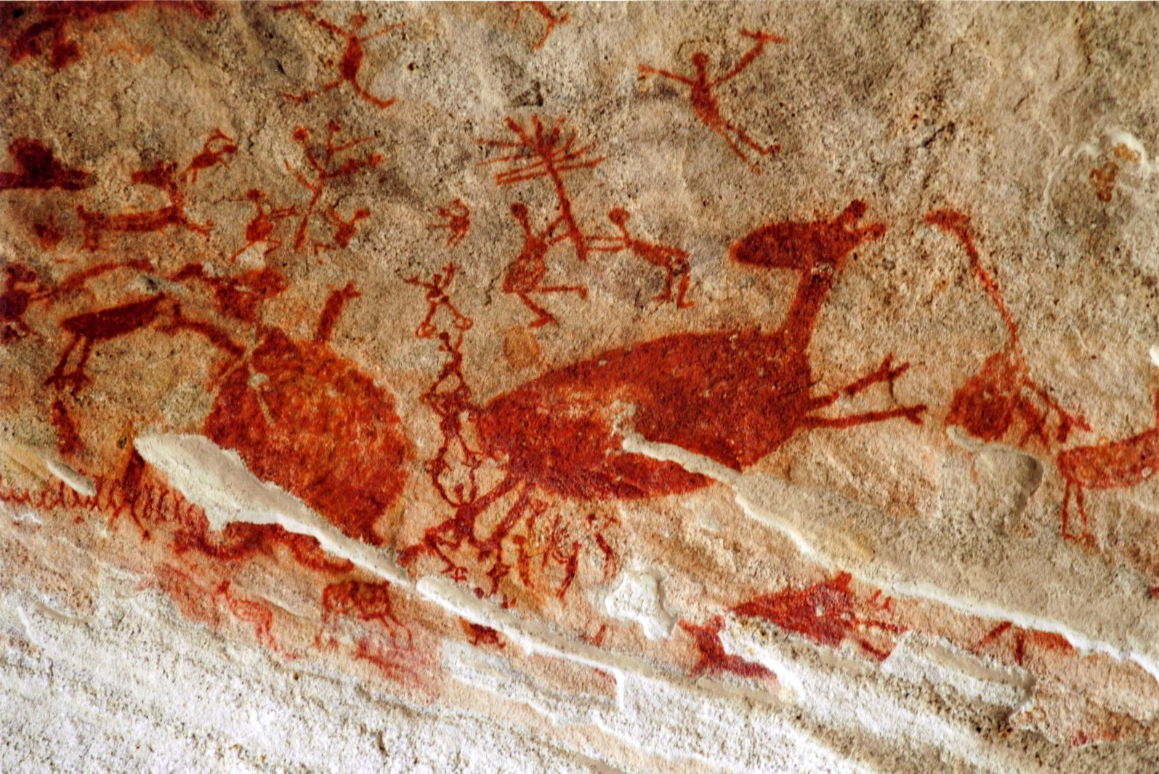
Notes:
Oldest remains of human ancestor 3.2 million years old (Lucy).
Modern humans have been around for about 200,000 years.
“It’s believed that humans originated about 200,000 years ago … in southern Africa. By 70,000 years ago, humans migrated out of Africa and began colonizing the entire planet. They spread to Eurasia and Oceania 40,000 years ago, and reached the Americas by 14,500 years ago.”
Our bodies and brains have been shaped by the environments we have lived in across time.
Think about what these environments have been …
Reference for quote above: http://www.universetoday.com/38125/how-long-have-humans-been-on-earth/#ixzz2EdqKnGBv

Slide 20
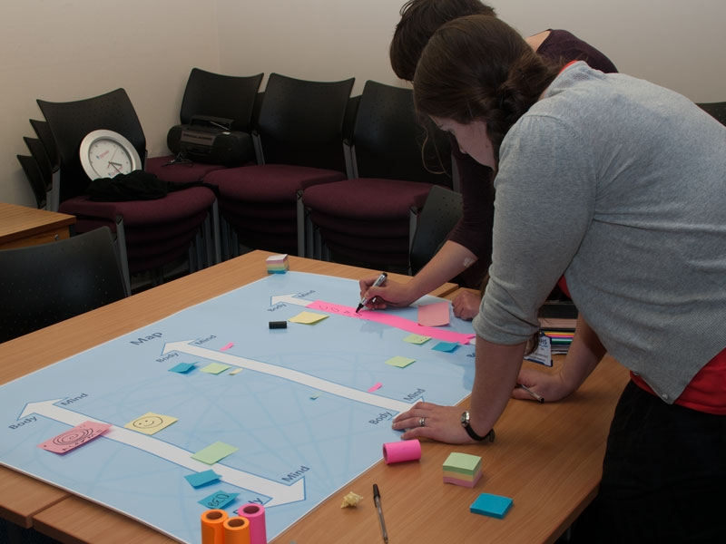

Slide 21
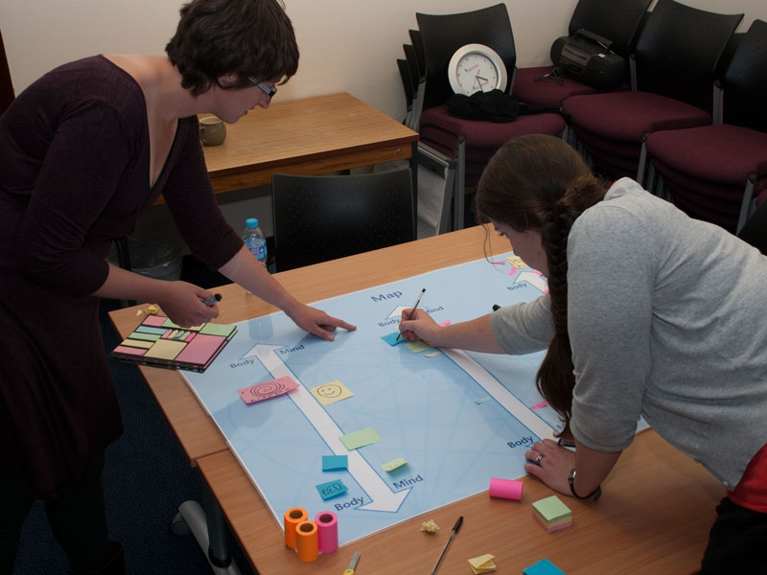

Slide 22
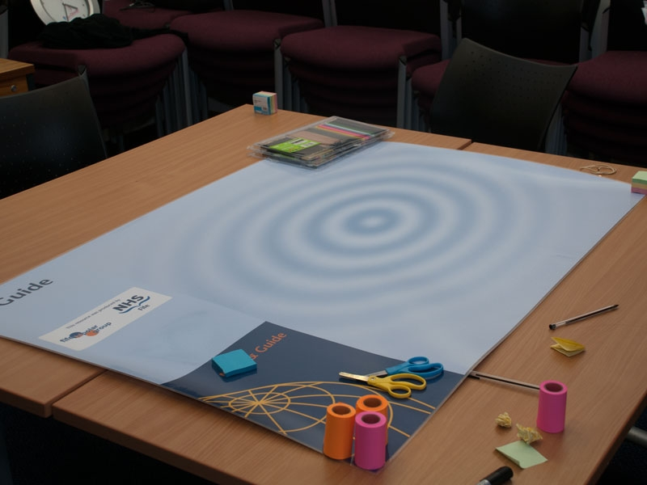

Slide 23
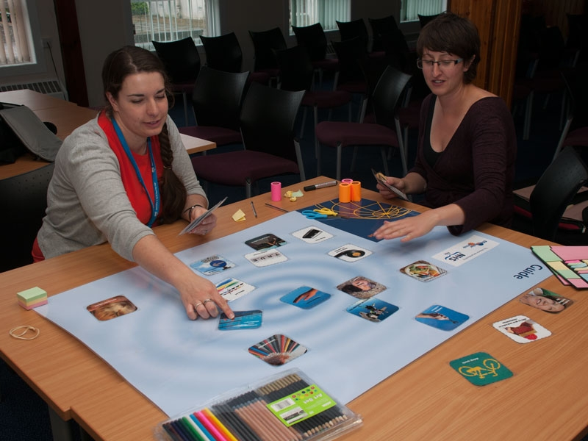

Slide 24
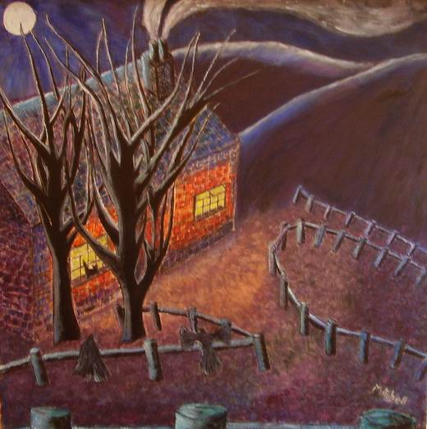
David Mitchell Swan
Notes:
24

Slide 25
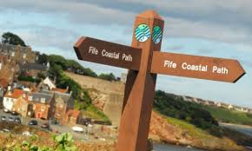
...the direction…
Encouraging exploration & communication
Bringing professionals on board
Ownership
Collaboration not participation
Visit Scotland
Notes:
“organic growth”
Staff involvement
Funding for developing training
2 main purposes: use of the approach/understanding and supporting use of approach; influencing practice in general– bringing staff on board
Spirit/philosophy
Enable people to communicate about experiences
Encouraging acceptance through discussing experience/affect states
Evolulution
Collaboration
Legitimacy
Context
Process

Slide 26
Pole to Pole
A resource for exploration in Bipolar

